Slide 1

Quantum Image Compression Using QPIA and NEQR Representations.
Akhillesh Varathan CS - CB.AI.U4AIM24103 Jeffrin Merino J - CB.AI.U4AIM24118 Deepak Skandh K - CB.AI.U4AIM24119 Kavin M - CB.AI.U4AIM24121
1

Slide 2
INTRODUCTION
1.Quantum image compression algorithms leverage the principles of quantum mechanics to represent and compress images in a more efficient way than classical algorithms.
2. Techniques like Quantum Pixel Intensity Adjustment (QPIA) and Novel Enhanced Quantum Representation (NEQR), often combined with Huffman coding, leverage quantum gates and transformations to efficiently encode and compress images.
2

Slide 3
PROBLEM STATEMENT
1. Classical methods struggle with large image datasets and lossless compression. 2.Existing quantum models need too many qubits and lack precision. 3.No unified framework combines intensity adjustment and efficient quantum encoding. 4. compress images using QPIA + NEQR + Huffman with high efficiency and minimal quality loss.
3

Slide 4
METHODOLOGY
Input image
Normalization
NEQR Encoding
QPIA Transformation
Intensity Inversion
Huffman encoding
Compressed Output
4

Slide 5
RESEARCH GAPS
1.NEQR requires many qubits, limiting scalability. 2.PIA was not originally designed for compression. 3.Existing methods lack adaptability for different image types. 4.FRQI-based models suffer from poor intensity precision.

Slide 6
APPLICATIONS
Quantum Big Data and Image Databases. 2. Medical Image Storage and Transmission.

Slide 7
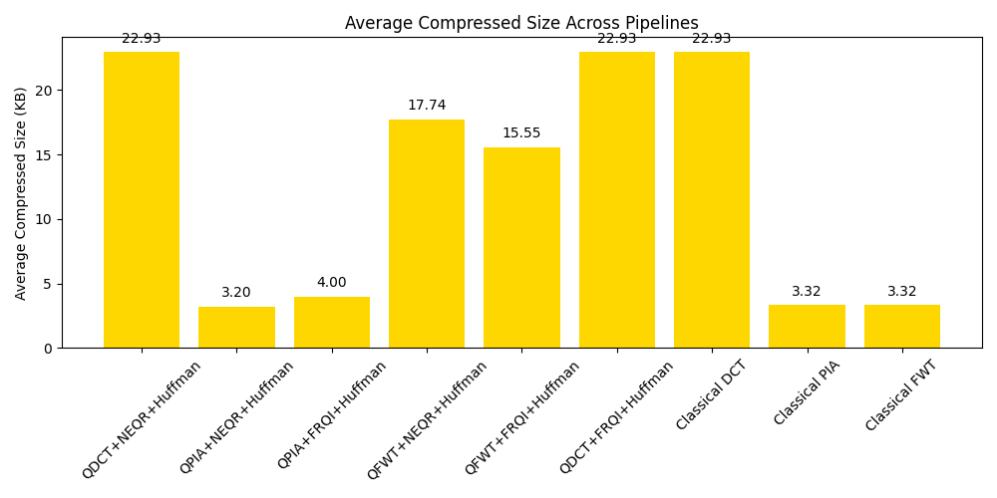
OUTPUT

Slide 8

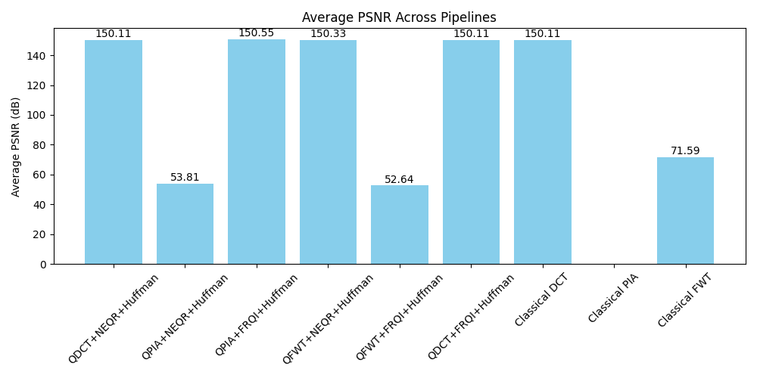
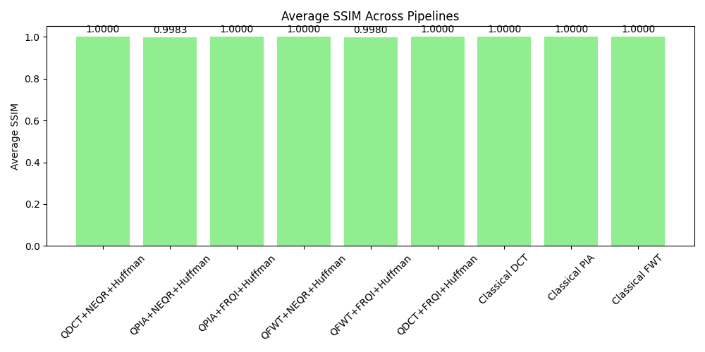
OUTPUT

Slide 9
THANK YOU

